Slide 1
Real-World Applications of AI and Machine Learning From Research to Industry
Thank you to the ICELTS 2025 & Study Abroad Program Team for the opportunity to share today’s workshop.

Slide 2
Real-World Applications of AI and Machine Learning From Research to Industry
This session draws inspiration from real-world research I’m conducting at ACU and Torrens University—focusing on how AI-powered and explainable systems can support ethical cybersecurity training in education and small businesses.
Presented by: Dr. Farshid Keivanian Affiliations: UTS | ACU | Torrens University | Higher Education Institutions in Sydney Event: ICELTS 2025 & Study Abroad Program Date & Time: 21 May 2025 | 2:30–4:30 PM Venue: Mathews Theatre B, UNSW Sydney

Slide 3
Introduction & Session Goals
Today’s Goals:
Discover real-world AI/ML applications
Bridge academic research with industry use cases
Engage in hands-on tasks and group discussion

Slide 4
What Is Artificial Intelligence?
AI = Simulating human intelligence in machines
Key Areas: Machine Learning, Natural Language Processing, Computer Vision, Robotics
Simple Real-Life Analogy: AI as your smart assistant (like Siri or ChatGPT)

Slide 5
AI, ML & Deep Learning — What’s the Difference?
Artificial Intelligence (AI) The big idea: teaching machines to think or act like humans. Example: A self-driving car making decisions on the road.
Machine Learning (ML) A part of AI that learns from data — no hard-coded rules. Example: Netflix suggesting movies based on what you watched.

Slide 6
AI, ML & Deep Learning — What’s the Difference?
Deep Learning (DL) A powerful type of ML that uses layers of "artificial neurons" to learn complex patterns. Example: Face recognition in your phone camera.
Real-world analogy: AI is like the whole school, ML is one class in that school, and DL is the smartest student in the class!

Slide 7
AI in Education – Making Learning Smarter
Smart Learning Platforms Like Coursera, they adjust content based on how you're doing—just like a personal coach.
AI Tutors Give instant feedback when you get stuck—like having a 24/7 study buddy.

Slide 8
AI in Education – Making Learning Smarter
Prediction Models Help teachers see who might struggle—like a weather forecast for your grades.
Real-world analogy: AI in education is like a GPS for learning—it shows where you are, helps you adjust your path, and guides you to your goal faster.

Slide 9
AI in Healthcare – Smarter, Faster, Safer
Disease Detection AI can spot signs of illness early (e.g., skin cancer) just by analyzing images—like a super-accurate medical assistant.
Patient Monitoring Predicts health issues before they happen—like a health "early warning system."

Slide 10
AI in Healthcare – Smarter, Faster, Safer
Drug Discovery Speeds up how we find new medicines by testing ideas using machine learning.
Real-world analogy: AI in healthcare is like a smart doctor that never sleeps—analyzing data 24/7 to save lives.

Slide 11
AI in Business & Marketing – Smarter Selling
Smart Recommendations Like Netflix or Amazon knowing what you want before you do.
24/7 Chatbots Virtual assistants that answer customer questions instantly—even at 2 AM!

Slide 12
AI in Business & Marketing – Smarter Selling
Behavior Prediction AI studies your clicks to guess what you’ll buy next—like a digital mind reader.
Real-world analogy: AI in business is like a personal shopper and support agent combined—working nonstop to boost sales and satisfaction.

Slide 13
AI in Cybersecurity – The Digital Bodyguard
Intrusion Detection AI spots unusual activity (like someone sneaking into your house at night).
Malware Classification Sorting good files from bad—like a spam filter but for viruses.

Slide 14
AI in Cybersecurity – The Digital Bodyguard
Ethical Hacking Using smart tools (like ZAP) + ML to test systems before real hackers do.
Real-world analogy: Think of AI as a smart security guard who learns over time what a real threat looks like—faster than any human could.

Slide 15
Case Study Activity (Group Task)
Provide a short real-world scenario (e.g., fake news detection)
What data is needed? What AI tools might help?
Discussion in pairs or small groups

Slide 16
Build a Simple Model (Guided Demo)
Using a small dataset (e.g., student performance or diabetes dataset)
Show basic steps: import data, preprocess, train a simple model, evaluate
Tools: Google Colab (if internet), or PowerPoint with screenshots

Slide 17
Ethics & Challenges
Making AI fairer and more trustworthy
Bias in AI: Sometimes AI learns stereotypes from data (e.g., hiring tools preferring one gender over another).

Slide 18
Ethics & Challenges
Privacy Issues: AI needs data—lots of it. But how do we protect personal info while training smart models?
Responsible AI (XAI & Fairness): We need to explain how AI makes decisions (XAI) and ensure it treats everyone fairly—like a fair referee in a game.

Slide 19
Research to Industry Path
Turning your ideas into real-world impact
From Uni to Industry: I’ll share how I moved from teaching & research into real AI industry projects.

Slide 20
Research to Industry Path
Practical Tips: Publishing your work, applying for internships, and collaborating with researchers or companies.
Your Growth Path: How to build your profile, gain hands-on experience, and make your skills stand out.

Slide 21
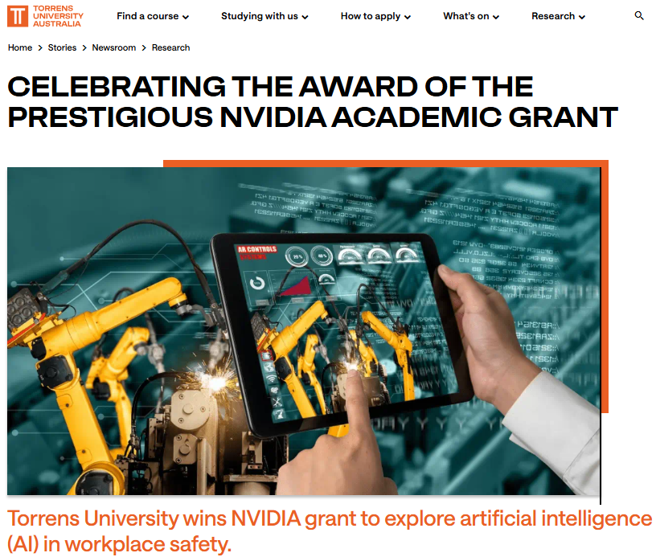
AI for Workplace Safety — Torrens x NVIDIA
What: NVIDIA-funded AI research on real-time safety management in construction
Who: Led by Prof. Tony Jan at Torrens’ AIRO Lab

Slide 22
AI for Workplace Safety — Torrens x NVIDIA
How: Physics-informed ML + Edge AI to detect collisions, structural risks, and unsafe worker behavior
Why it matters: Predictive safety saves lives, supports the construction industry, and shows how AI goes beyond tech

Slide 23
Applied Research in Action
ACU Research Project Proposal: Ethical AI for Penetration Testing in Cyber Labs
→ Tools: ZAP, Nmap, SHAP, LIME
→ Goal: Help students learn ethical hacking using explainable AI

Slide 24
Applied Research in Action
Torrens Proposal: XR & LLM-based AI tutors for cybersecurity training
→ AI tutors that give real-time feedback in virtual labs
→ Goal: Boost confidence and skills through immersive learning
Outcome: Open-source tools, student research, grant submissions

Slide 25
Applied Research in Action
Tic-Tac-Toe with Functions & AI Logic
Shows modular coding with functions (e.g., check_winner(), draw_board())
Introduces AI with rule-based or minimax decision-making
A fun way to learn about loops, conditionals, and algorithm design

Slide 26
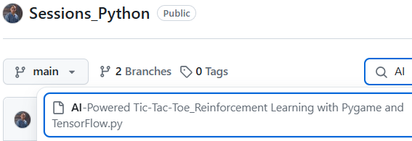
Applied Research in Action
The game is a standard Tic-Tac-Toe where two players ("Human" and "AI") take turns to mark spaces in a 3x3 grid.

Slide 27
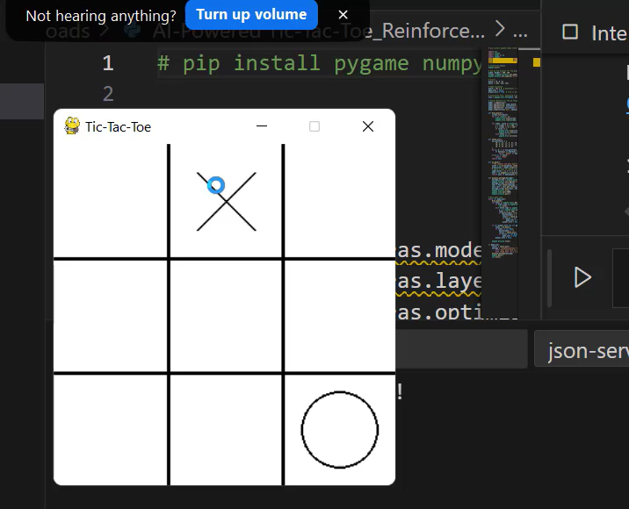
Applied Research in Action
The objective is to achieve three consecutive marks horizontally, vertically, or diagonally. The game ends when all spaces are filled or a player wins.

Slide 28
Modular Code through Functions: Functions allow for code reusability, readability, and modularity. The code breaks down the game logic into well-defined functions, demonstrating the principles of structured programming.

Slide 29
Examples of Functions in the Code:
These functions encapsulate logic, making the program more organized and reusable.
Function Name | Purpose
draw_board() | Draws the Tic-Tac-Toe grid and updates the display.
check_win() | Checks if a player has won or if the game is a draw.
ai_move() | Uses the trained neural network to predict the AI’s next move.
display_message(message) | Displays the final game result on a new window.

Slide 30
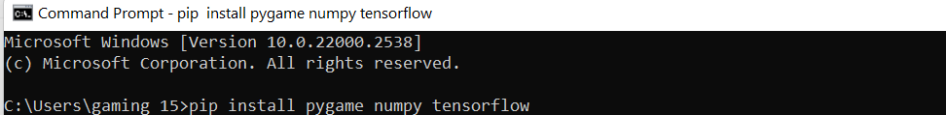
Modular Programming and AI: Implementing Functions in a Tic-Tac-Toe Game
pip install pygame numpy tensorflow
Before running the code, make sure these necessary libraries are installed.
Required Libraries
Before running the code, make sure you have these libraries installed:
pygame for the game interface.
numpy for handling arrays and matrix operations.
TensorFlow for machine learning components.

Slide 31
Modular Programming and AI: Implementing Functions in a Tic-Tac-Toe Game
Import Necessary Libraries
import sys
import random
import numpy as np
import pygame
from tensorflow.keras.models import Sequential
from tensorflow.keras.layers import Dense
from tensorflow.keras.optimizers import Adam
Imports: Necessary libraries for game mechanics, neural networks, and basic Python functionality.

Slide 32
Modular Programming and AI: Implementing Functions in a Tic-Tac-Toe Game
# Initialize Pygame
pygame.init()
# Set up the display for the game
width, height = 300, 300
screen = pygame.display.set_mode((width, height))
pygame.display.set_caption('Tic-Tac-Toe')
# Colors
black = (0, 0, 0)
white = (255, 255, 255)
# Game variables
board = [0] * 9 # Represents a 3x3 grid
game_over = False
player_turn = True # True if player's turn, False for AI
# Initialize font, adjusting size to fit better
font = pygame.font.Font(None, 28)
# Neural Network for the AI Player
model = Sequential()
model.add(Dense(64, input_dim=9, activation='relu')) # Input layer for 9 board positions
model.add(Dense(64, activation='relu')) # Hidden layer
model.add(Dense(9, activation='linear')) # Output layer for each move's Q-value
model.compile(loss='mse', optimizer=Adam())
2. Initilisation:
Pygame Initialization: Starts the Pygame engine to manage game elements.
Display Setup: A window of size 300x300 pixels is created.
Font Initialization: A font of size 28 is created for text rendering.
Model Initialization: A neural network model with three layers is defined and compiled for predicting AI moves.

Slide 33

3. Drawing the Board:
def draw_board():
screen.fill(white)
for i in range(1, 3):
pygame.draw.line(screen, black, (0, 100 * i), (300, 100 * i), 3)
pygame.draw.line(screen, black, (100 * i, 0), (100 * i, 300), 3)
for index, value in enumerate(board):
x = (index % 3) * 100 + 50
y = (index // 3) * 100 + 50
if value == 1:
pygame.draw.line(screen, black, (x - 25, y - 25), (x + 25, y + 25), 2)
pygame.draw.line(screen, black, (x + 25, y - 25), (x - 25, y + 25), 2)
elif value == -1:
pygame.draw.circle(screen, black, (x, y), 34, 2)
Draw Lines: Draws the Tic-Tac-Toe grid.
Draw Marks: Depending on the board state, draws 'X' or 'O' in the appropriate grid cell.

Slide 34

4. Win Condition Check:
def check_win():
win_positions = [
(0, 1, 2), (3, 4, 5), (6, 7, 8),
(0, 3, 6), (1, 4, 7), (2, 5, 8),
(0, 4, 8), (2, 4, 6)
]
for a, b, c in win_positions:
if board[a] == board[b] == board[c] != 0:
return 'Human' if board[a] == 1 else 'AI'
if 0 not in board:
return 'Draw'
return None
Winning Positions: Checks predefined winning line combinations.
Determine Winner: Returns which player won or if the game is a draw.

Slide 35
Modular Programming and AI: Implementing Functions in a Tic-Tac-Toe Game
5. AI decision making
def ai_move():
"""AI chooses the best move based on the neural network prediction."""
state = np.array(board).reshape(1, -1)
predictions = model.predict(state)[0]
# Apply a mask to remove illegal moves (positions already taken)
legal_moves = [i if x == 0 else -1e7 for i, x in enumerate(board)]
move = np.argmax(np.array(predictions) + np.array(legal_moves))
return move if board[move] == 0 else None
Predictive Model: Uses the neural network to predict the move values based on the current board state.
Legal Moves: Ensures the AI only considers legal (empty) positions.
Choose Best Move: The AI picks the position with the highest predicted value.

Slide 36
Modular Programming and AI: Implementing Functions in a Tic-Tac-Toe Game
6. Message Display
def display_message(message):
message_screen = pygame.display.set_mode((300, 150))
pygame.display.set_caption('Game Over')
message_screen.fill(white)
text = font.render(message, True, black)
text_rect = text.get_rect(center=(150, 75))
message_screen.blit(text, text_rect)
pygame.display.flip()
pygame.time.wait(2000)
pygame.display.quit()
New Window: Opens a new smaller window to display the game result.
Render and Display Text: Shows the final game outcome.

Slide 37
Modular Programming and AI: Implementing Functions in a Tic-Tac-Toe Game
# Main game loop
while not game_over:
draw_board()
for event in pygame.event.get():
if event.type == pygame.QUIT:
sys.exit()
elif event.type == pygame.MOUSEBUTTONDOWN and event.button == 1 and player_turn:
x, y = pygame.mouse.get_pos()
index = (x // 100) + (y // 100) * 3
if board[index] == 0:
board[index] = 1
result = check_win()
if result is not None:
game_over = True
player_turn = False
if not player_turn and not game_over:
index = ai_move()
if index is not None:
board[index] = -1
result = check_win()
if result is not None:
game_over = True
player_turn = True
pygame.display.flip()
if game_over:
result = check_win()
message = "Congratulations! You've won the game!" if result == 'Human' \
else "Your hard work is commendable, but you need to try more." if result == 'AI' \
else "Game Over. It's a draw."
display_message(message)
pygame.quit()
sys.exit()
7. Main Game Loop
Event Handling: Processes quitting the game or human player moves.
AI Moves: If it's the AI's turn, it calculates and makes a move.
Update Display: Refreshes the game window to reflect the current state.

Slide 38
Engagement
Would you be interested in working on real-world AI research like this during your degree?

Slide 39
Engagement
If you were to apply AI in your local community or future job—what problem would you solve?

Slide 40
Q&A + Study Abroad Advice
Any questions about AI, studying in Australia, industry pathways?
Encourage curiosity and networking

Slide 41
Win a Ticket to the Vogue Codes Summit 2025!
For Sydney-Based Tech Students
Event Date: 14 June 2025 Location: Sydney | Hosted by CBA Prize: FREE ticket (valued at $199) to an exclusive women-in-tech innovation summit!

Slide 42
Win a Ticket to the Vogue Codes Summit 2025!
How to Apply: Visit: commbank.com.au/vogue-codes-summit Answer in 100 words: “Who inspired you to pursue a tech career, and how did they influence you?”
Deadline: 5:00 PM (AEST), 28 May 2025

Slide 43
Win a Ticket to the Vogue Codes Summit 2025!
Eligibility:
Age 18+
Living in NSW
Studying STEM (e.g., IT, Cyber ecurity, CompSci)
Current tertiary student in Australia

Slide 44
Win a Ticket to the Vogue Codes Summit 2025!
Why Apply? Meet tech leaders | Build networks | Boost your career journey!

Slide 45
Contact
keivanian@gmail.com | Farshid.Keivanian@uts.edu.au | Farshid.Keivanian@torrens.edu.au | Farshid.Keivanian@acu.edu.au | LinkedIn: Dr Farshid Keivanian GitHub: Farshid Keivanian
Follow up for advice or mentoring
Final words: Start small, but start today. AI needs your curiosity.

Slide 46

Thank You

